Slide 1
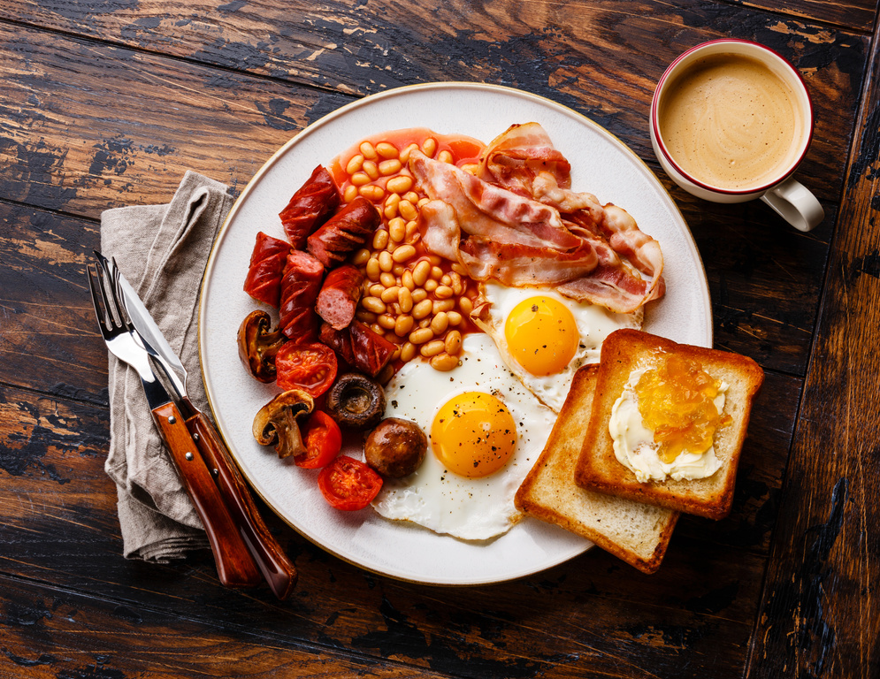
Self: Activities that work on the individual
CFO Evolution – March 2025
Relationships: Activities that work with peers/families/friends
Monday 3rd | Tuesday 4th | Wednesday 5th | Thursday 6th | Friday 7th
Introduction to Basic Cooking skills 9:30am - 10:30am Shrove Tuesday (Pancake making) 10:30am – 12pm With Katie | Employment research with Steve 10.00-12.00 | Employability Researching chosen job profiles for suitability CV Support Email creation. Tailored CV’s - digital copy for job search Skills assessment – identify which skills needed for chosen job role. 10.00 – 13.00 | Future Focus Goal setting! 10am – 12pm | Mindfulness with Megan! 10am – 11am Understanding Diversity in Society 11am – 12pm
 | Through the Gate Hub induction (support available for anyone being released from custody) 13.00pm-14.00pm CFO Evolution information session (meet the team and enrol!) 14.00
Healthy Relationships 1pm – 3pm With Katie |  | Hub closed 1pm – 5pm | Head in the Game – Mental health and fitness 1pm-2pm With Mark International Women’s Day 2pm – 4pm With Carol | Yoga/Mindful movements 13.30-14.30 With Megan Quiz/Social games 15.00-16.00
Society: Activities contributing to the community outside of the CFO Activity Hub
Doncaster Activity Hub
Unit 25/27 7 Queens Crescent Doncaster DN1 3JN
If you ever need a cuppa or a chat, pop in and speak to your support worker.
Reception contact number: 07502299992
9:30am – 16:00pm
Monday – Friday
This programme is delivered by HMPPS CFO

Slide 2
Self: Activities that work on the individual
CFO Evolution – March 2025
Relationships: Activities that work with peers/families/friends
Monday 10th | Tuesday 11th | Wednesday 12th | Thursday 13th | Friday 14th
Introduction to Basic Cooking skills 9:30am - 10:30am Cooking on a budget 10:30am – 12pm With Katie | Employment research with Steve 10.00-12.00 | Hub closed All day. | Future Focus Goal setting! 10am – 12pm | Mindfulness with Megan! 10am – 11am Understanding Diversity in Society 11am – 12pm
 | Through the Gate Hub induction (support available for anyone being released from custody) 13.00pm-14.00pm CFO Evolution information session (meet the team and enrol!) 14.00
Healthy Relationships 1pm – 3pm With Katie |  |  | Mission Nutrition – Health eating for your wellbeing 13:00-14:00 Head in the Game – Mental health and fitness 14:30-15:30 With Mark | Yoga/Mindful movements 13.30-14.30 With Megan Quiz/Social games 15.00-16.00
Society: Activities contributing to the community outside of the CFO Activity Hub
Doncaster Activity Hub
Unit 25/27 7 Queens Crescent Doncaster DN1 3JN
If you ever need a cuppa or a chat, pop in and speak to your support worker.
Reception contact number: 07502299992
9:30am – 16:00pm
Monday – Friday
This programme is delivered by HMPPS CFO

Slide 3
Self: Activities that work on the individual
CFO Evolution – March 2025
Relationships: Activities that work with peers/families/friends
Monday 17th | Tuesday 18th | Wednesday 19th | Thursday 20th | Friday 21st
Introduction to Basic Cooking skills 9:30am - 10:30am Cooking on a budget 10:30am – 12pm With Katie | Employment research with Steve 10.00-12.00 | Employability Researching chosen job profiles for suitability CV Support Email creation. Tailored CV’s - digital copy for job search Skills assessment – identify which skills needed for chosen job role. 10.00 – 13.00 | Future Focus Goal setting! 10am – 12pm | Mindfulness with Megan! 10am – 11am Understanding Neurodiversity 11am – 12pm
 | Through the Gate Hub induction (support available for anyone being released from custody) 13.00pm-14.00pm CFO Evolution information session (meet the team and enrol!) 14.00
Healthy Relationships 1pm – 3pm With Katie |  | Arts and Crafts 1pm – 3pm | Mission Nutrition – Health eating for your wellbeing 13:00-14:00 Head in the Game – Mental health and fitness 14:30-15:30 With Mark | Yoga/Mindful movements 13.30-14.30 With Megan Quiz/Social games 15.00-16.00
Society: Activities contributing to the community outside of the CFO Activity Hub
Doncaster Activity Hub
Unit 25/27 7 Queens Crescent Doncaster DN1 3JN
If you ever need a cuppa or a chat, pop in and speak to your support worker.
Reception contact number: 07502299992
9:30am – 16:00pm
Monday – Friday
This programme is delivered by HMPPS CFO

Slide 4
Self: Activities that work on the individual
CFO Evolution – March 2025
Relationships: Activities that work with peers/families/friends
Monday 24th | Tuesday 25th | Wednesday 26th | Thursday 27th | Friday 28th
Introduction to Basic Cooking skills 9:30am - 10:30am Cooking on a budget 10:30am – 12pm With Katie | Employment research with Steve 10.00-12.00 | Employability Researching chosen job profiles for suitability CV Support Email creation. Tailored CV’s - digital copy for job search Skills assessment – identify which skills needed for chosen job role. 10.00 – 13.00 | Future Focus Goal setting! 10am – 12pm | Mindfulness with Megan! 10am – 11am Understanding Diversity in Society 11am – 12pm
 | Through the Gate Hub induction (support available for anyone being released from custody) 13.00pm-14.00pm CFO Evolution information session (meet the team and enrol!) 14.00
Healthy Relationships 1pm – 3pm With Katie |  | Arts and Crafts 1pm – 3pm | Mission Nutrition – Health eating for your wellbeing 13:00-14:00 Head in the Game – Mental health and fitness 14:30-15:30 With Mark | Yoga/Mindful movements 13.30-14.30 With Megan Quiz/Social games 15.00-16.00
Society: Activities contributing to the community outside of the CFO Activity Hub
Doncaster Activity Hub
Unit 25/27 7 Queens Crescent Doncaster DN1 3JN
If you ever need a cuppa or a chat, pop in and speak to your support worker.
Reception contact number: 07502299992
9:30am – 16:00pm
Monday – Friday
This programme is delivered by HMPPS CFO

