Slide 1


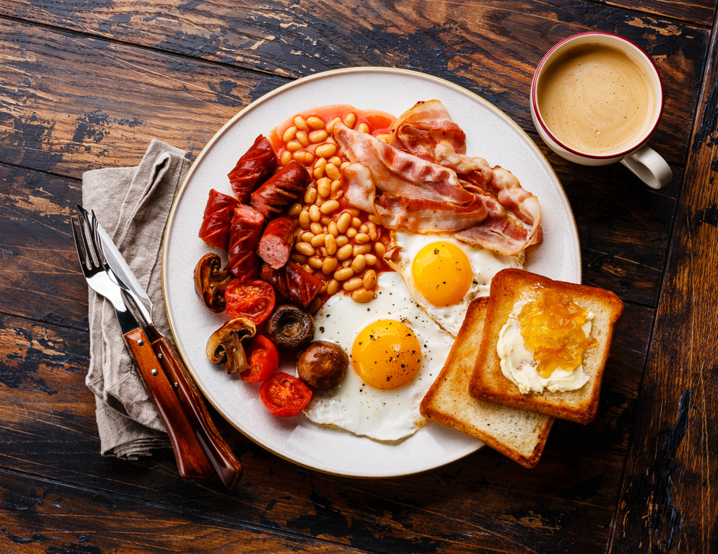








Self: Activities that work on the individual
CFO Evolution – September 2025
Relationships: Activities that work with peers/families/friends
Monday 1st | Tuesday 2nd | Wednesday 3rd | Thursday 4th | Friday 5th
CBT Sessions 10:00 – 14:00 Cooking on a budget 10:30 – 12:30 With Sharon | CBT Sessions 10:00 -15:00 Enrolment Session and Meet the Team for Prison releases- Through the Gate inductions 10:00 – 13:00 | Baking 9:30 – 12:00 With Rachel Man plan with Steve 10:00 – 12:00 Men’s mental health group | Employability Researching chosen job profiles for suitability CV Support Email creation. Tailored CV’s - digital copy for job search Skills assessment – identify which skills needed for chosen job role. 10am – 2pm IT Literacy/ Learn the basics and improve your IT Skills With Jenny 2pm – 3pm | Recipe for Success 11:30 – 13:30 Cook breakfast, Networking around local jobs and agencies etc. .
 | Personal development sessions . Improving Communication/Time Management/ Building Confidence 13:00 – 15:00
UPW Session 13:00 – 15:00pm Housing Agencies/ GP/Dentist/ ID General Support 13:30 – 15:30 |  | Arts and Crafts 13:00 – 15:00 |  | Quiz/Social games 13:00 - 15:00
Society: Activities contributing to the community outside of the CFO Activity Hub
Doncaster CFO Activity Hub
Unit 25/27
7 Queens Crescent
Doncaster
DN1 3JN
If you ever need a cuppa or a chat, pop in and speak to your support worker.
Reception contact number: 07502299992
9:30am – 16:00pm
Monday – Friday
This programme is delivered by HMPPS CFO

Slide 2
Self: Activities that work on the individual
CFO Evolution – September 2025
Relationships: Activities that work with peers/families/friends
Monday 8th | Tuesday 9th | Wednesday 10th | Thursday 11th | Friday 12th
Cooking on a budget 10:30 – 12:30 With Sharon | Enrolment Session and Meet the Team for Prison releases Through the Gate inductions 10 - 13:00 | Baking 9:30 – 12:00 With Rachel Man plan with Steve 10.00 – 12.00 Men’s mental health support | Employability Researching chosen job profiles for suitability CV Support Email creation. Tailored CV’s - digital copy for job search Skills assessment – identify which skills needed for chosen job role. 10am – 2pm IT Literacy/ Learn the basics and improve your IT Skills With Jenny 2pm – 3pm | Recipe for Success 9:30 – 11:30 Cook breakfast, Networking around local jobs and agencies etc.
 | Personal development sessions Improving Communication/ Time Management/ Building Confidence etc 13:00 – 15:00
UPW Session 13:30 – 15:30pm Housing Agencies/ GP/Dentist/ ID General Support 13:30 – 15:30 |  | Arts and Crafts 13:00 – 15:00 |  | Quiz/Social games 13:00-15:00
Society: Activities contributing to the community outside of the CFO Activity Hub
Doncaster CFO Activity Hub
Unit 25/27
7 Queens Crescent
Doncaster
DN1 3JN
If you ever need a cuppa or a chat, pop in and speak to your support worker.
Reception contact number: 07502299992
9:30am – 16:00pm
Monday – Friday
This programme is delivered by HMPPS CFO

Slide 3
Self: Activities that work on the individual
CFO Evolution – September 2025
Relationships: Activities that work with peers/families/friends
Monday 15th | Tuesday 16th | Wednesday 17th | Thursday 18th | Friday 19th
CBT Sessions 10:00 – 14:00 Cooking on a budget 10:30 – 12:30 With Sharon | CBT Sessions 10:00 -14:00 Enrolment Session and Meet the Team for Prison releases- Through the Gate inductions 10:00 – 13:00 | Manplan with Steve 10.00 – 12.00 Men’s mental health support | Employability Researching chosen job profiles for suitability CV Support Email creation. Tailored CV’s - digital copy for job search Skills assessment – identify which skills needed for chosen job role. 10am – 2pm IT Literacy/ Learn the basics and improve your IT Skills With Jenny 2pm – 3pm | Wellbeing Walk and Talk 10:00 – 11:30 Recipe for Success 11.30am – 1.30pm Cook breakfast, Networking around local jobs and agencies etc.
 | Personal development sessions Improving Communication/ Time Management/ Building Confidence etc 13:00 – 15:00
UPW Session 13:00 – 15:30 Housing Agencies/ GP/Dentist/ ID General Support 13:30 – 15:30 |  | Arts and Crafts 13:00 – 15:00 |  | Quiz/Social games 13:00 – 15:00
Society: Activities contributing to the community outside of the CFO Activity Hub
Doncaster CFO Activity Hub
Unit 25/27
7 Queens Crescent
Doncaster
DN1 3JN
If you ever need a cuppa or a chat, pop in and speak to your support worker.
Reception contact number: 07502299992
9:30am – 16:00pm
Monday – Friday
This programme is delivered by HMPPS CFO

Slide 4
Self: Activities that work on the individual
CFO Evolution – September 2025
Relationships: Activities that work with peers/families/friends
Monday 22nd | Tuesday 23rd | Wednesday 24th | Thursday 25th | Friday 26th
Cooking on a budget 10:30 – 12:30 With Sharon | Enrolment Session and Meet the Team for Prison releases- Through the Gate inductions 10:00 – 13:00 | Manplan with Steve 10.00 – 12.00 Men’s mental health support | Employability Researching chosen job profiles for suitability CV Support Email creation. Tailored CV’s - digital copy for job search Skills assessment – identify which skills needed for chosen job role. 10am – 2pm IT Literacy/ Learn the basics and improve your IT Skills With Jenny 2pm – 3pm | Macmillan Coffee Morning 9:30 - 11.30 Charity baking
 | Personal development sessions Improving Communication/ Time Management/ Building Confidence etc 13:00 – 15:00pm
UPW Session 13:30 – 15:30 Housing Agencies/ GP/Dentist/ ID General Support 13:30 – 15:30 |  | Arts and Crafts 1pm – 3pm |  | Quiz/Social games 13.00-15.00
Society: Activities contributing to the community outside of the CFO Activity Hub
Doncaster CFO Activity Hub
Unit 25/27
7 Queens Crescent
Doncaster
DN1 3JN
If you ever need a cuppa or a chat, pop in and speak to your support worker.
Reception contact number: 07502299992
9:30am – 16:00pm
Monday – Friday
This programme is delivered by HMPPS CFO

Slide 5
Self: Activities that work on the individual
CFO Evolution – September 2025
Relationships: Activities that work with peers/families/friends
Monday 29th | Tuesday 30th | Wednesday 1st Oct | Thursday 2nd Oct | Friday 3rd Oct
CBT Sessions 10:00 – 14:00 Cooking on a budget 10:30 – 12:30 With Sharon | CBT Sessions 10:00 -14:00 Enrolment Session and Meet the Team for Prison releases- Through the Gate inductions 10:00 – 13:00 | Manplan with Steve 10:00 – 12:00 Men’s mental health support | Employability Researching chosen job profiles for suitability CV Support Email creation. Tailored CV’s - digital copy for job search Skills assessment – identify which skills needed for chosen job role. 10am – 2pm IT Literacy/ Learn the basics and improve your IT Skills With Jenny 2pm – 3pm | Wellbeing Walk and Talk 10am–11.30am Recipe for Success 11:30 – 13:30 Cook breakfast, Networking around local jobs and agencies etc.
 | Personal development sessions Improving Communication/ Time Management/ Building Confidence etc 13:00 – 15:00
UPW Session 13:30 – 15:30 Housing Agencies/ GP/Dentist/ ID General Support 13:30 – 15:30 |  | Arts and Crafts 13:00 – 15:00 |  | Quiz/Social games 13.00-15.00
Society: Activities contributing to the community outside of the CFO Activity Hub
Doncaster CFO Activity Hub
Unit 25/27
7 Queens Crescent
Doncaster
DN1 3JN
If you ever need a cuppa or a chat, pop in and speak to your support worker.
Reception contact number: 07502299992
9:30am – 16:00pm
Monday – Friday
This programme is delivered by HMPPS CFO

