Slide 1






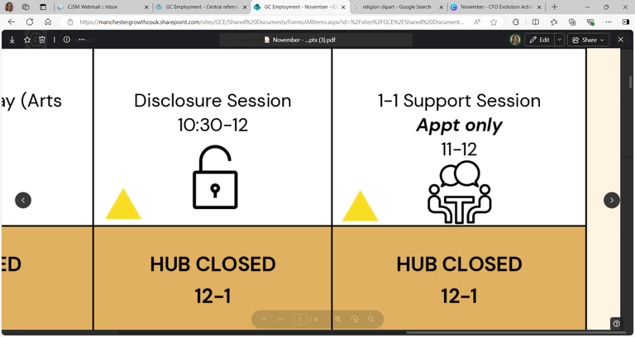


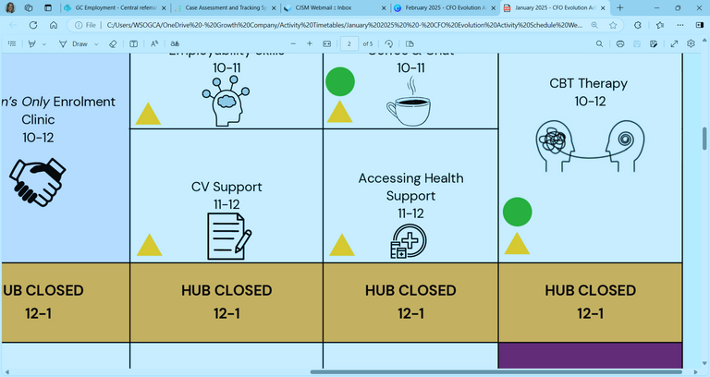





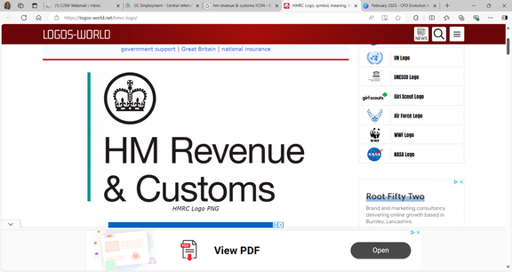












Self: Activities that work on the individual
AUGUST - WEEK 1
Relationships: Activities that work with peers/families/friends
Society: Activities contributing to the community outside of the CFO Activity Hub
Monday 28th | Tuesday 29th |  | Wednesday 30th | Thursday 31st |  | Friday 1st
Women’s Only Relationship Advice & Support 9:30 - 11 |  |  | International Friendship Day: Building Healthy Friendships within the Community Advice & Guidance Session 9:30 - 12
Women’s Only Accessing Health Support 11 - 12
HUB CLOSED 12-1 | HUB CLOSED 12-1 |  | HUB CLOSED 12-1 | HUB CLOSED 12-1 |  | HUB CLOSED 12-1
CV Support 1 - 2 |  |  |  | Digital College 1 - 2:30 |  | Confidence Building 1 - 2
 |  |  | Problem Solving Techniques 3 - 4 |  |  | Digital Skills Support 2 - 4
Address:
First Floor Offices, Crabtree Street, Furthergate Industrial Estate, Blackburn, BB1 3BD
Contact Information:
07775 096192 (Gabriella)
07384 119231 (Nadya)
07712 511792 (Aisha)
Enrolments are needed to do any of the activities.
Our 1:1 activities include; Housing, Employment, Training, Money Management, Healthcare and Enrolment, or you can book specific 1-1 support session with your support worker.
They are appointment only!
We offer group sessions such as Hub Walks around Corporation Park, Coffee & Chat Sessions, a Hub Quiz, various Arts and Craft sessions, and Cooking Sessions. Employment activities included Interview Prep, Completing Application Forms or just simply support with Job Searching/Training.
Disclosure Session
9:30 - 11
1-1 Support Session
Appt only
9:30 - 10:30
Job Club
9:30 - 12
Where to Start and an Introduction to Employability
9:30 - 12
CBT
Appt only
10 - 12
Obtaining National Insurance
11 - 12
Enrolment Clinic
10:30 - 12
Accessing Health Support
1 - 2
TiPP
Art Session
1 - 3
CBT Therapy
Appt only
2 - 4
TiPP
Drama
Music
2 - 4
Cooking Session:
Chicken Curry
2 - 4
ETE Awards & Quiz
2:30 - 4
This programme is delivered by HMPPS CFO

Slide 2
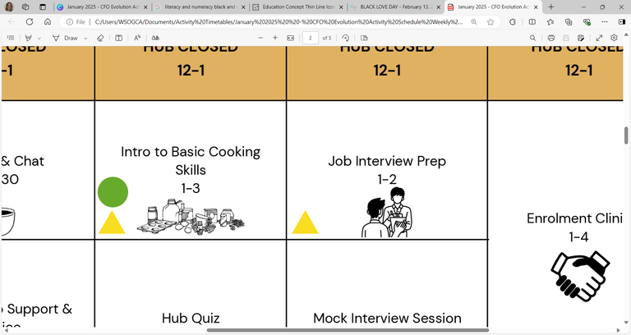









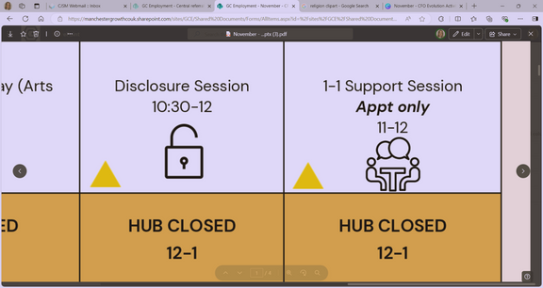
Self: Activities that work on the individual
AUGUST - WEEK 2
Relationships: Activities that work with peers/families/friends
Society: Activities contributing to the community outside of the CFO Activity Hub
Monday 4th | Tuesday 5th |  | Wednesday 6th | Thursday 7th | Friday 8th
Digital College 9:30 - 12 |  |  | Interview Preparation 9:30 - 10:30 | Disclosure Session 9:30 – 10:30
 |  |  | Mock Interviews 10:30 - 12 | CV Support 10:30 - 12
HUB CLOSED 12-1 | HUB CLOSED 12-1 |  | HUB CLOSED 12-1 | HUB CLOSED 12-1 | HUB CLOSED 12-1
 |  |  |  | Women’s Only Housing Support 1 – 2:30
 |  |  | Accessing Benefit Support 3 - 4 | Women’s Only Disclosure Session 2:30 - 4
Address:
First Floor Offices, Crabtree Street, Furthergate Industrial Estate, Blackburn, BB1 3BD
Contact Information:
07775 096192 (Gabriella)
07384 119231 (Nadya)
07712 511792 (Aisha)
Enrolments are needed to do any of the activities.
Our 1:1 activities include; Housing, Employment, Training, Money Management, Healthcare and Enrolment, or you can book specific 1-1 support session with your support worker.
They are appointment only!
We offer group sessions such as Hub Walks around Corporation Park, Coffee & Chat Sessions, a Hub Quiz, various Arts and Craft sessions, and Cooking Sessions. Employment activities included Interview Prep, Completing Application Forms or just simply support with Job Searching/Training.
Obtaining a Bank Account
9:30 - 11
1-1 Support Sessions
Appt only
9:30 - 12
Enrolment Clinic
9:30 - 12
CBT
Appt only
10 - 12
Industry Specific Cards
11 - 12
Mindfulness Strategies
1 - 2
Motivation Session
1 - 2:30
Healthy Living
Non-accredited Course
1 - 4
TiPP
Art Session
1 - 3
CBT Therapy
Appt only
2 - 4
TiPP
Drama
Music
2 - 4
Feelings of Hope & Self-Efficiency
2:30 - 4
This programme is delivered by HMPPS CFO

Slide 3

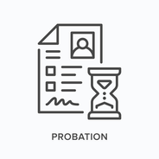



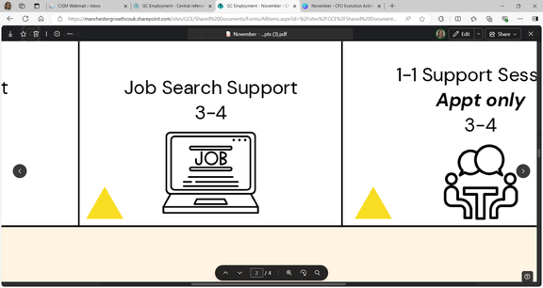






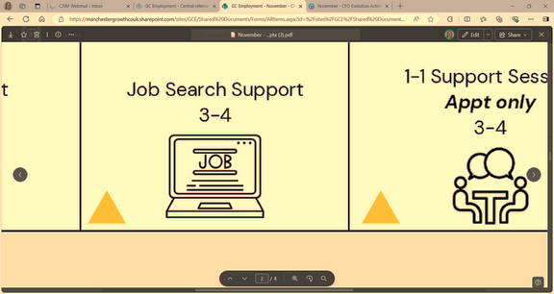

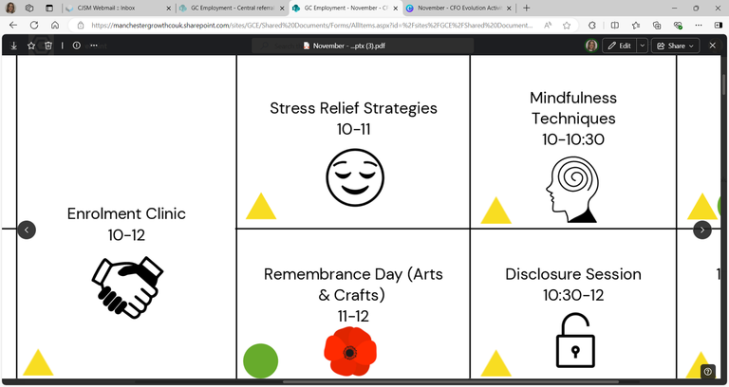
Self: Activities that work on the individual
AUGUST - WEEK 3
Relationships: Activities that work with peers/families/friends
Society: Activities contributing to the community outside of the CFO Activity Hub
Monday 11th | Tuesday 12th |  | Wednesday 13th | Thursday 14th |  |  | Friday 15th
Unpaid Work Support 9:30 - 11 |  |  |  |  |  |  | Job Applications: Cover Letter Support 9:30 - 11
Employability Skills 11 - 12
HUB CLOSED 12-1 | HUB CLOSED 12-1 |  | HUB CLOSED 12-1 | HUB CLOSED 12-1 |  |  | HUB CLOSED 12-1
Reflective Practice 1 - 2 |  |  |  | Healthy Eating & Living Techniques 1 – 2:30 |  |  | Budgeting Support 1 - 2:30
 |  |  | Mindfulness Yoga 3 - 4 | Stress Relief Strategies 2:30 - 4
CV Support
9:30 - 11
Obtaining ID
9:30 – 10:30
In Work Support
9:30 - 12
Enrolment Clinic
9:30 - 12
CBT
Appt only
10 - 12
Job Search
11 - 12
Sentence Requirement Support
10:30 - 12
Non-accredited & Accredited Course Searching
11 - 12
Women’s Only
CV Support
1 - 2:30
TiPP
Art Session
1 - 3
CBT Therapy
Appt only
2 - 4
TiPP
Drama
Music
2 - 4
Women’s Only
Job Search
2:30 - 4
Feelings of Hope & Self-Efficiency
2:30 - 4
This programme is delivered by HMPPS CFO

Slide 4




Self: Activities that work on the individual
AUGUST - WEEK 4
Relationships: Activities that work with peers/families/friends
Society: Activities contributing to the community outside of the CFO Activity Hub
Monday 18th | Tuesday 19th |  | Wednesday 20th | Thursday 21st |  | Friday 22nd
Future Focus 9:30 - 11 |  |  | Women’s Only Sentence Requirement Support 9:30 - 11 | 1-1 Support Session Appt only 9:30 - 10:30 | In Work Support 9:30 - 12 | Interview Preparation 9:30 – 10:30
Obtaining National Insurance 11 - 12 |  |  | Women’s Only Benefit Support 11 - 12 |  | Disclosure Session 11 – 12 | Unpaid Work Support 10:30 - 12
HUB CLOSED 12-1 | HUB CLOSED 12-1 |  | HUB CLOSED 12-1 | HUB CLOSED 12-1 |  | HUB CLOSED 12-1
Motivation Workshop 1 - 2 |  |  | TiPP Art Session 1 - 3 | Emotional Resilience 3 - 4 |  | Healthy Living Non-accredited Course 1 - 3
 |  |  | Confidence Building 3 - 4 | Pasta Bake Cooking Session 2 - 4 |  | Problem Solving Techniques 3 - 4
Enrolment Clinic
9:30 - 12
CBT
Appt only
10 - 12
World Humanitarian Day:
Awareness, Activities & Volunteering Opportunities
1 - 4
CBT
Appt only
1 - 4
TiPP
Drama
Music
2 - 4
This programme is delivered by HMPPS CFO

Slide 5








Self: Activities that work on the individual
AUGUST - WEEK 5
Relationships: Activities that work with peers/families/friends
Society: Activities contributing to the community outside of the CFO Activity Hub
Monday 25th | Tuesday 26th |  | Wednesday 27th | Thursday 28th |  | Friday 29th
 | Digital College 9:30 - 11 |  | Job Club 9:30 - 12 | Enrolment Clinic 9:30 – 10:30 |  | Hub Canal Walk 9:30 - 12
HUB CLOSED 12-1 | HUB CLOSED 12-1 |  | HUB CLOSED 12-1 | HUB CLOSED 12-1 |  | HUB CLOSED 12-1
Mindfulness Techniques 1 - 2 |  |  |  | Women’s Only Motivation Session 1 – 2 |  | Goal Setting Session 1 – 2:30
 |  |  | Sports: Ping Pong 3 - 4 | Women’s Only Digital College 2 - 4 |  | ETE Awards & Quiz 2:30 - 4
Where to Start and an Introduction to Employability
9:30 - 12
Bank Holiday
HUB CLOSED
CBT
Appt only
10 - 12
Job Search
11 - 12
Future Focus
10:30 - 12
Job Search & Applications
10:30 - 12
Anger Management Support
1 - 2
TiPP
Art Session
1 - 3
CBT Therapy
Appt only
1 - 4
TiPP
Drama
Music
2 - 4
Banana Bread
Baking Session
2 - 4
This programme is delivered by HMPPS CFO

