Slide 1
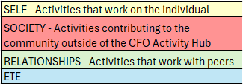
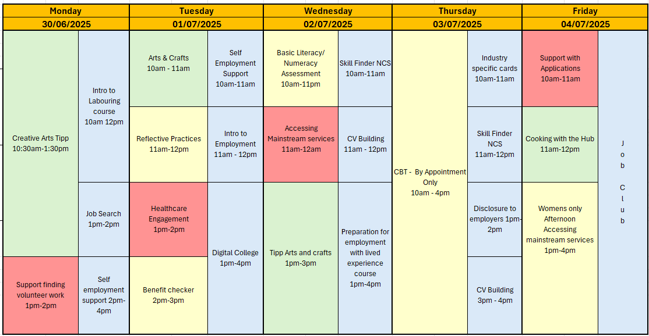
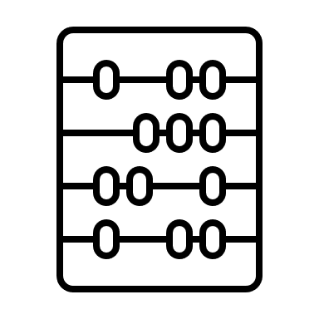
JULY - WEEK 1
Address: - Urban Exchange, Theatre Street/Mount Street, Preston, PR1 8BQ
Contact: 07850 955413 (AMY)
Enrolments to be completed before joining any sessions
Group Activity's this week include Arts and Crafts and Creative arts which will be run by an external provider as well as a cooking session (we advise you join the food safety course prior) – Please let your support worker know if you would like to sign up for any of these.
Sessions to be booked Via appointment
10am-12pm
This programme is delivered by HMPPS CFO
V1.0

Slide 2
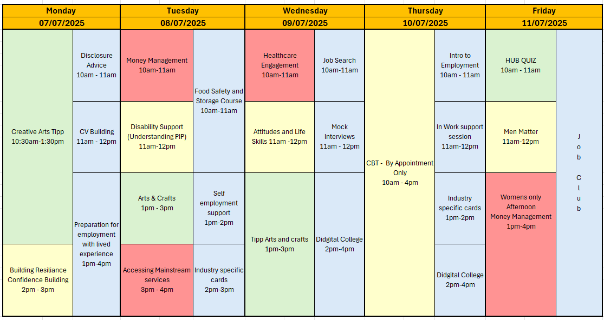
JULY - WEEK 2
Address: - Urban Exchange, Theatre Street/Mount Street, Preston, PR1 8BQ
Contact: 07850 955413 (AMY)
Enrolments to be completed before joining any sessions
Group Activity's this week include Arts and Crafts and Creative arts which will be run by an external provider – Please let your support worker know if you would like to sign up for any of these.
Additionally, A men matter group will be run by one of the male support workers discussing men’s mental health struggles.
This programme is delivered by HMPPS CFO
V1.0

Slide 3
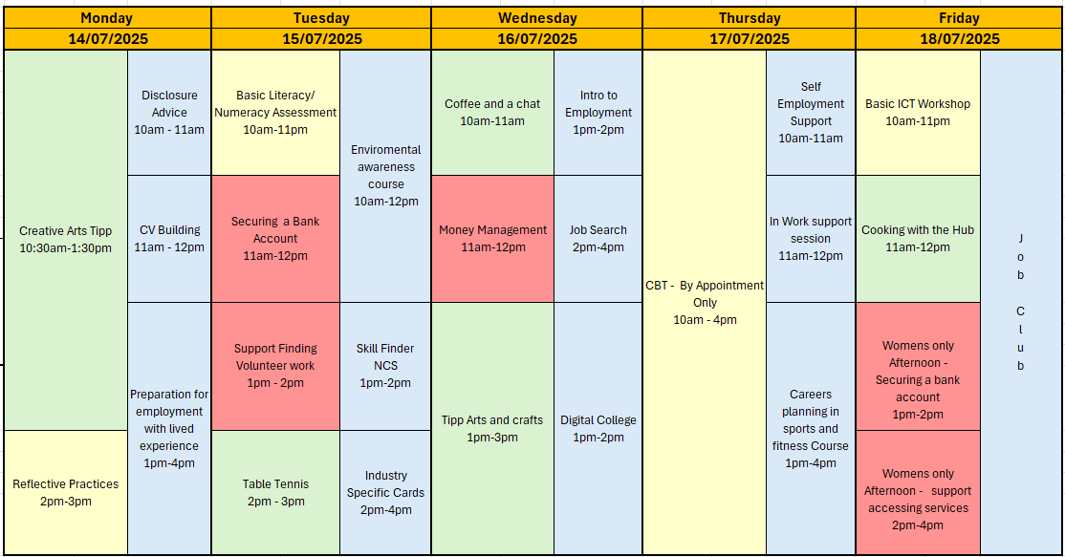
JULY - WEEK 3
Address: - Urban Exchange, Theatre Street/Mount Street, Preston, PR1 8BQ
Contact: 07850 955413 (AMY)
Enrolments to be completed before joining any sessions
Group Activity's this week include Arts and Crafts, Table tennis and Creative arts which will be run by an external provider – Please let your support worker know if you would like to sign up for any of these.
Each Month we will be running a Hub focus group during coffee and a chat giving you the opportunity to express your opinions and suggestions to improve the service.
Hub Closed
9am-5pm
This programme is delivered by HMPPS CFO
V1.0

Slide 4
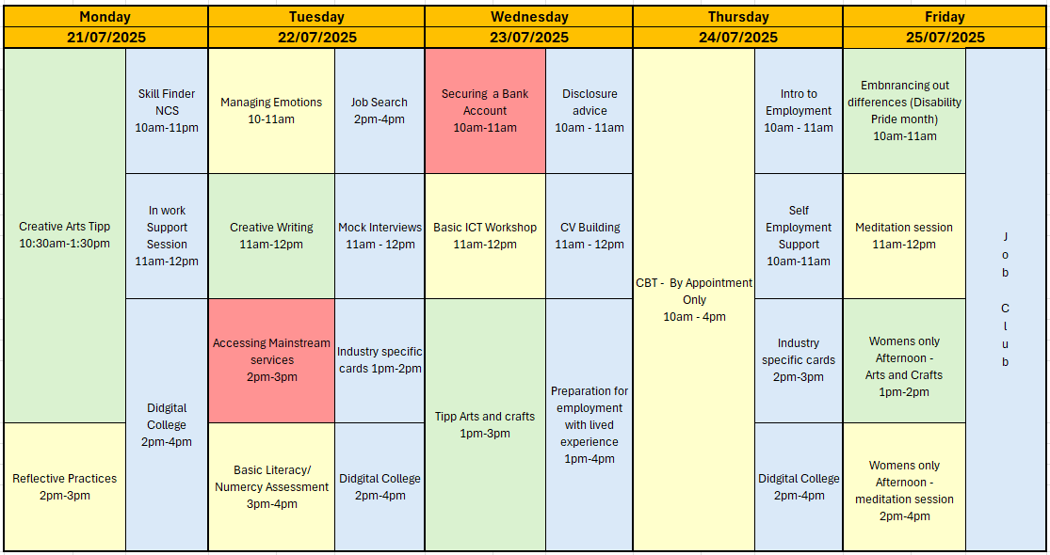
JULY - WEEK 4
Address: - Urban Exchange, Theatre Street/Mount Street, Preston, PR1 8BQ
Contact: 07850 955413 (AMY)
Enrolments to be completed before joining any sessions
Group Activity's this week include Creative Writing, Art group and Creative art group run by Tipp– Please let your support worker know if you would like to sign up for any of these.
This programme is delivered by HMPPS CFO
V1.0

Slide 5
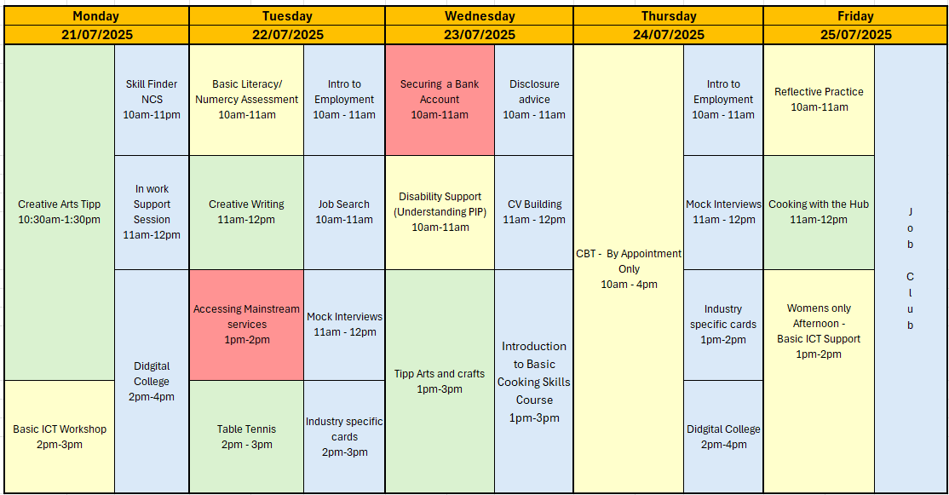
JULY - WEEK 5
Address: - Urban Exchange, Theatre Street/Mount Street, Preston, PR1 8BQ
Contact: 07850 955413 (AMY)
Enrolments to be completed before joining any sessions
Group Activity's this week include Creative Writing, Table tennis, Art group and Creative art group run by Tipp– Please let your support worker know if you would like to sign up for any of these.
This programme is delivered by HMPPS CFO
V1.0

