Slide 1
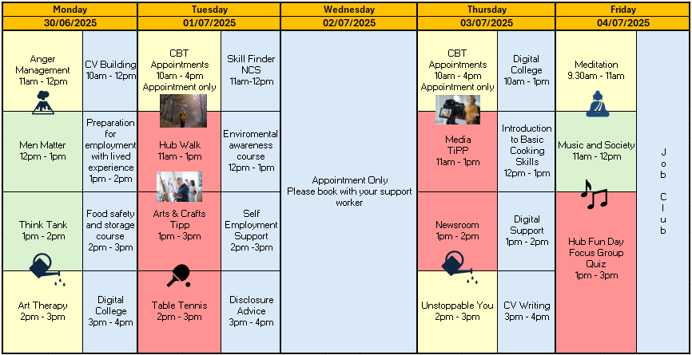
Self: Activities that work on the individual
JULY – WEEK 1
Relationships: Activities that work with peers/families/friends
Education Training and Employment activities
Information
Manchester Community Hub
Address: 7 Watson Street, M3 4EE Please Contact: 07834 764 900 or 07731 132 7221
The green sessions are to support you build a pro social outlook, work on building relationships and team building with peers at the hub.
Our Blue sessions focus on education training and employment to help you gain employment and upskill to move toward the job market.
Our yellow sessions support you to work on your self development and build a positive outlook
This programme is delivered by HMPPS CFO

Slide 2
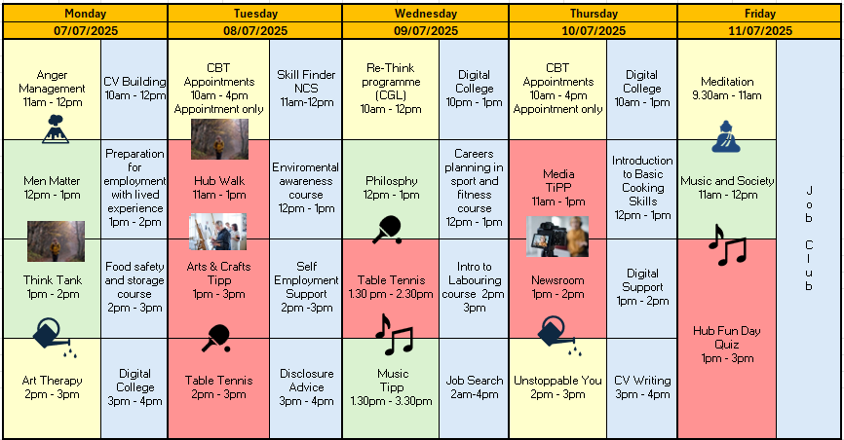
Self: Activities that work on the individual
JULY - WEEK 2
Relationships: Activities that work with peers/families/friends
Education Training and Employment activities
Information
Manchester Community Hub
Address: 7 Watson Street, M3 4EE Please Contact: 07834 764 900 or 07731 132 7221
The green sessions are to support you build a pro social outlook work on building relationships and team building with peers at the hub.
Our Blue sessions focus on education training and employment to help you gain employment and upskill to move toward the job market.
Our yellow sessions support you to work on your self development and build a positive outlook
This programme is delivered by HMPPS CFO

Slide 3
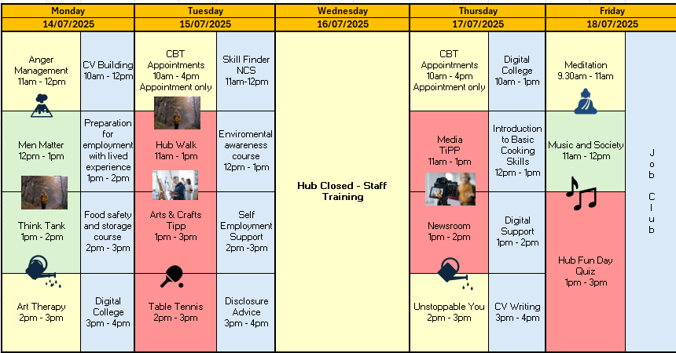
Self: Activities that work on the individual
JULY - WEEK 3
Relationships: Activities that work with peers/families/friends
Education Training and Employment activities
Information
Manchester Community Hub
Address: 7 Watson Street, M3 4EE Please Contact: 07834 764 900 or 07731 132 7221
The green sessions are to support you build a pro social outlook work on building relationships and team building with peers at the hub.
Our Blue sessions focus on education training and employment to help you gain employment and upskill to move toward the job market.
Our yellow sessions support you to work on your self development and build a positive outlook
This programme is delivered by HMPPS CFO

Slide 4
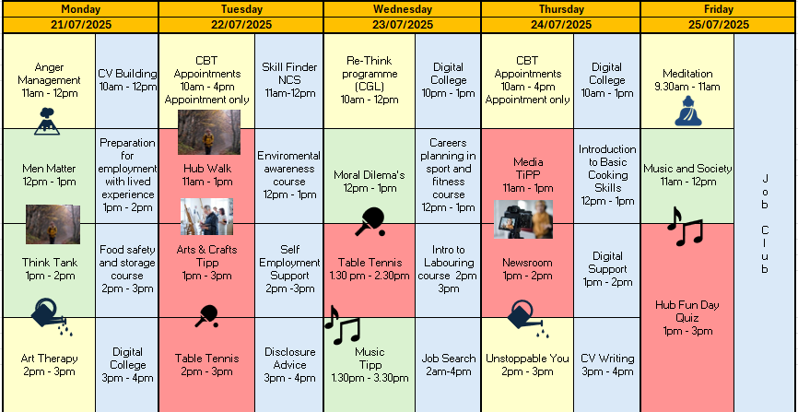
Self: Activities that work on the individual
JULY - WEEK 4
Relationships: Activities that work with peers/families/friends
Education Training and Employment activities
Information
Manchester Community Hub
Address: 7 Watson Street, M3 4EE Please Contact: 07834 764 900 or 07731 132 7221
The green sessions are to support you build a pro social outlook work on building relationships and team building with peers at the hub.
Our Blue sessions focus on education training and employment to help you gain employment and upskill to move toward the job market.
Our yellow sessions support you to work on your self development and build a positive outlook
This programme is delivered by HMPPS CFO

Slide 5
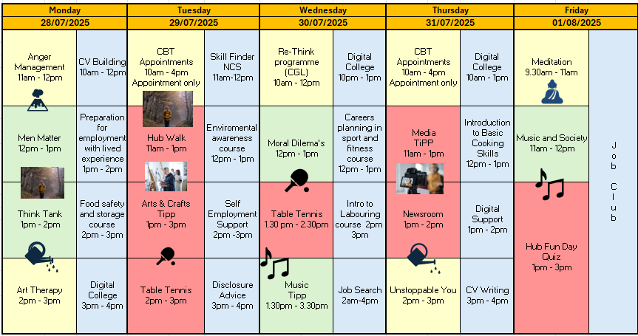
Self: Activities that work on the individual
JULY - WEEK 5
Relationships: Activities that work with peers/families/friends
Education Training and Employment activities
Information
Manchester Community Hub
Address: 7 Watson Street, M3 4EE Please Contact: 07834 764 900 or 07731 132 7221
The green sessions are to support you build a pro social outlook work on building relationships and team building with peers at the hub.
Our Blue sessions focus on education training and employment to help you gain employment and upskill to move toward the job market.
Our yellow sessions support you to work on your self development and build a positive outlook
This programme is delivered by HMPPS CFO

