Slide 1
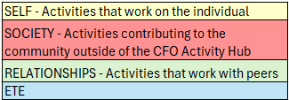


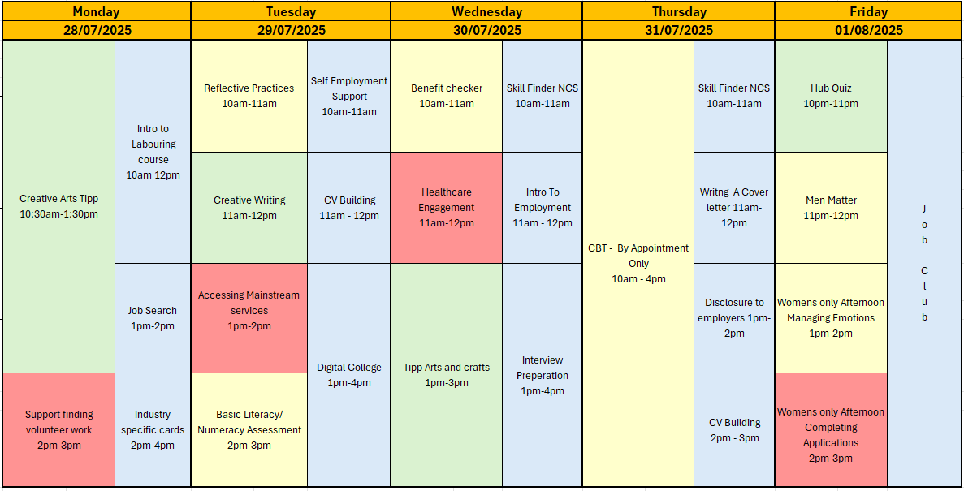














AUGUST - WEEK 1
Information
Address: - Urban Exchange, Theatre Street/Mount Street, Preston, PR1 8BQ
Contact: 07850 955413 (AMY)
Enrolments are needed to do any of the sessions.
Group Activity's this week include Arts and Crafts, and Creative arts which will be run by an external provider additionally there is a creative writing group and A men matter group which will be run by one of the male support workers discussing men’s mental health struggles.
– Please let your support worker know if you would like to sign up for any of these.
CBT To be discussed with Support worker
This programme is delivered by HMPPS CFO
V1.0

Slide 2
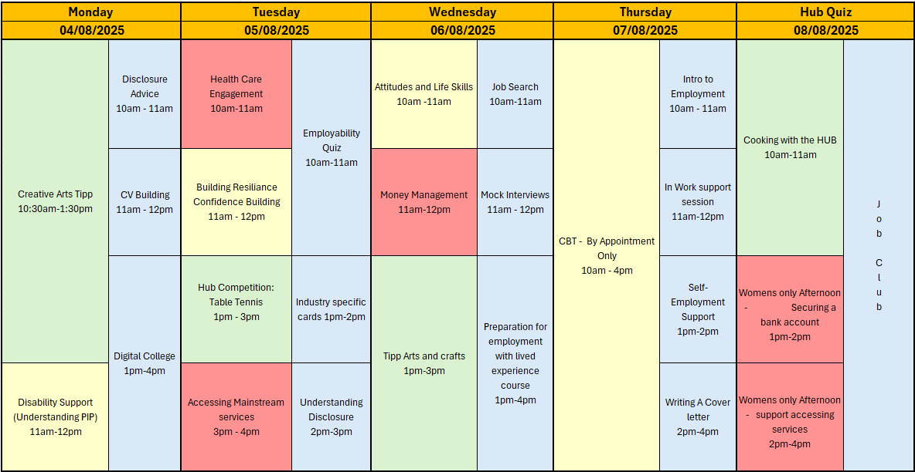






AUGUST - WEEK 2
Information
Address: - Urban Exchange, Theatre Street/Mount Street, Preston, PR1 8BQ
Contact: 07850 955413 (AMY)
Enrolments are needed to do any of the sessions.
Group Activity's this week include Arts and Crafts, Creative arts and A table tennis competition as well as the Cooking session (we advise you join the food safety course prior) and Creative arts which will be run by an external provider – Please let your support worker know if you would like to sign up for any of these.
CBT To be discussed with Support worker
This programme is delivered by HMPPS CFO
V1.0

Slide 3
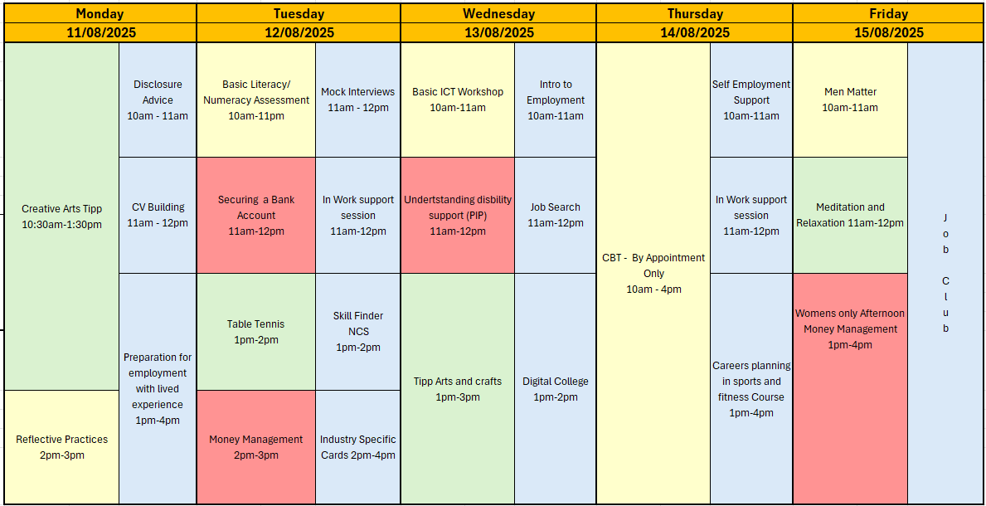

AUGUST - WEEK 3
Information
Address: - Urban Exchange, Theatre Street/Mount Street, Preston, PR1 8BQ
Contact: 07850 955413 (AMY)
Enrolments are needed to do any of the sessions.
Group Activity's this week include Arts and Crafts and Creative arts which will be run by an external provider and , Table tennis, A men matter group which will be run by one of the male support workers discussing men’s mental health struggles.
– Please let your support worker know if you would like to sign up for any of these.
CBT To be discussed with Support worker
This programme is delivered by HMPPS CFO
V1.0

Slide 4
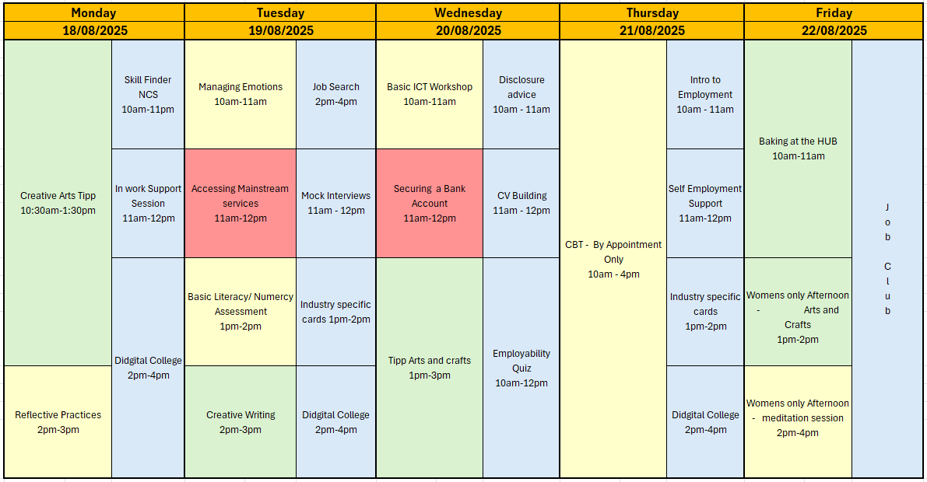

AUGUST - WEEK 4
Information
Address: - Urban Exchange, Theatre Street/Mount Street, Preston, PR1 8BQ
Contact: 07850 955413 (AMY)
Enrolments are needed to do any of the sessions.
Group Activity's this week include Creative Writing, and the Creative art group run by Tipp as well as a basic ICT workshop– Please let your support worker know if you would like to sign up for any of these.
We will also be running a baking session at the Hub this week
CBT To be discussed with Support worker
3pm-4pm
This programme is delivered by HMPPS CFO
V1.0

Slide 5
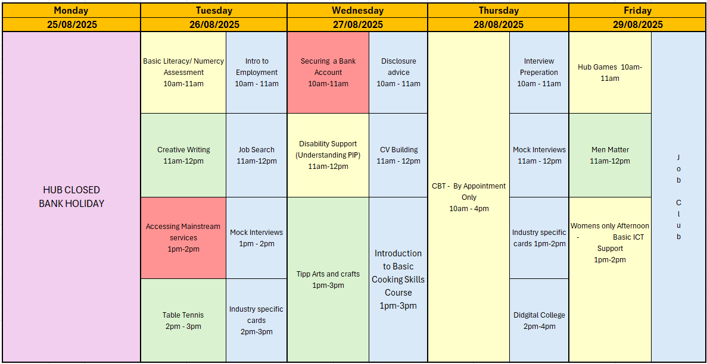

AUGUST - WEEK 5
Information
Address: - Urban Exchange, Theatre Street/Mount Street, Preston, PR1 8BQ
Contact: 07850 955413 (AMY)
Enrolments are needed to do any of the sessions.
Group Activity's this week include Creative Writing, Table tennis and the art group run by Tipp– Please let your support worker know if you would like to sign up for any of these.
CBT To be discussed with Support worker
HUB IS CLOSED MONDAY 25TH FOR BANK HOLIDAY
This programme is delivered by HMPPS CFO
V1.0

