Slide 1
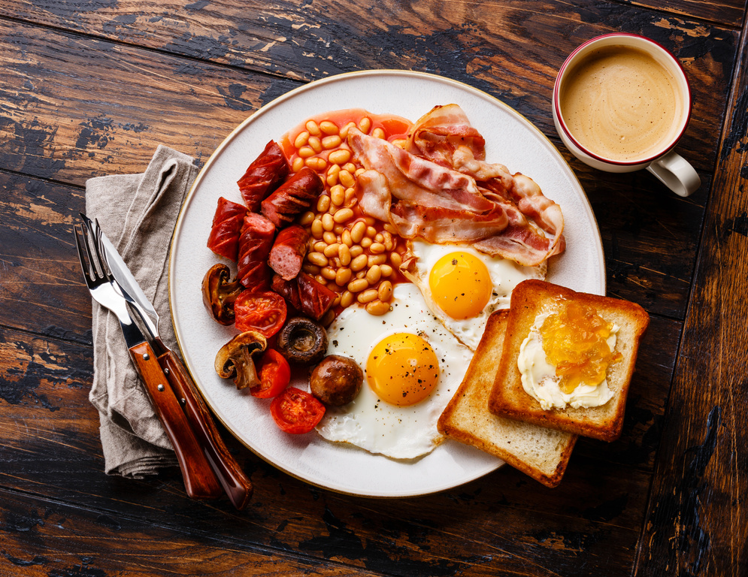
Self: Activities that work on the individual
CFO Evolution – July 2025
Relationships: Activities that work with peers/families/friends
Monday 30th | Tuesday 1st | Wednesday 2nd | Thursday 3rd | Friday 4th
Introduction to Basic Cooking skills 9:30am - 10:30am | Employment research with Steve 10.00-12.00 | Manplan with Steve 10 – 12.00 weekly Men’s mental health support | Employability Researching chosen job profiles for suitability CV Support Email creation. Tailored CV’s All day | Recipe for Success- 9.30 – 11.00 Come in to the hub, cook breakfast, Networking around local jobs and agencies etc.
 | Through the Gate Hub induction (support available for anyone being released from custody) 13.00pm-15.00pm
Healthy Relationships 1pm – 3pm |  | Arts and Crafts 1pm – 3pm |  | Quiz/Social games 13 00-16.00
Society: Activities contributing to the community outside of the CFO Activity Hub
Doncaster CFO Activity Hub
Unit 25/27 7 Queens Crescent Doncaster DN1 3JN
If you ever need a cuppa or a chat, pop in and speak to your support worker.
Reception contact number: 07502299992
9:30am – 16:00pm
Monday – Friday
This programme is delivered by HMPPS CFO

Slide 2
Self: Activities that work on the individual
CFO Evolution – July 2025
Relationships: Activities that work with peers/families/friends
Monday 7th | Tuesday 8th | Wednesday 9th | Thursday 10th | Friday 11th
Introduction to Basic Cooking skills 10am - 12.00pm | Hub closed All day | Manplan with Steve 10.00am – 12.00pm Men’s mental health group | Employability Researching chosen job profiles for suitability CV Support Email creation. Tailored CV’s - digital copy for job search Skills assessment – identify which skills needed for chosen job role. All day | Recipe for Success- 9.3am– 11.30pm Come in to the hub, cook breakfast, Networking around local jobs and agencies etc.
Baking 1.30pm – 3pm With Rachel |  | Arts and Crafts 1pm – 3pm |  | Quiz/Social games 13.00am-15.00pm
Society: Activities contributing to the community outside of the CFO Activity Hub
Doncaster CFO Activity Hub
Unit 25/27 7 Queens Crescent Doncaster DN1 3JN
If you ever need a cuppa or a chat, pop in and speak to your support worker.
Reception contact number: 07502299992
9:30am – 16:00pm
Monday – Friday
This programme is delivered by HMPPS CFO

Slide 3
Self: Activities that work on the individual
CFO Evolution – July 2025
Relationships: Activities that work with peers/families/friends
Monday 14th | Tuesday 15th | Wednesday 16th | Thursday 17th | Friday 18th
Introduction to Basic Cooking skills 9:30am - 10:30am Cooking on a budget 10:30am – 12pm With Rach | Employment research with Steve/Jenny 10.00-12.00 | Manplan with Steve 10.00 – 12.00 Men’s mental health support | Employability Researching chosen job profiles for suitability CV Support Email creation. Tailored CV’s - digital copy for job search Skills assessment – identify which skills needed for chosen job role. All day | Recipe for Success- 9.30 – 11.30 Come in to the hub, cook breakfast, Networking around local jobs and agencies etc.
 | Through the Gate Hub induction (support available for anyone being released from custody) 13.00pm-15.00pm CFO Evolution information session (meet the team and enrol!)
Baking 1pm – 3pm With Rachel |  | Arts and Crafts 1pm – 3pm |  | Quiz/Social games 13.00-15.00
Society: Activities contributing to the community outside of the CFO Activity Hub
Doncaster CFO Activity Hub
Unit 25/27 7 Queens Crescent Doncaster DN1 3JN
If you ever need a cuppa or a chat, pop in and speak to your support worker.
Reception contact number: 07502299992
9:30am – 16:00pm
Monday – Friday
This programme is delivered by HMPPS CFO

Slide 4
Self: Activities that work on the individual
CFO Evolution – July 2025
Relationships: Activities that work with peers/families/friends
Monday 21stth | Tuesday 22nd | Wednesday 23rd | Thursday 24th | Friday 25th
Introduction to Basic Cooking skills 9:30am - 10:30am | Employment research with Steve/Jenny 10.00-12.00 | Manplan with Steve 10.00 – 12.00 Men’s mental health support | Employability Researching chosen job profiles for suitability CV Support Email creation. Tailored CV’s - digital copy for job search Skills assessment – identify which skills needed for chosen job role. All day | Recipe for Success- 9.30 – 11.30 Come in to the hub, cook breakfast, Networking around local jobs and agencies etc.
 | Through the Gate Hub induction (support available for anyone being released from custody) 13.00pm-14.00pm CFO Evolution information session (meet the team and enrol!)
Baking with Rach, 1pm – 3pm |  | Arts and Crafts 1pm – 3pm |  | Quiz/Social games 13.00-15.00
Society: Activities contributing to the community outside of the CFO Activity Hub
Doncaster CFO Activity Hub
Unit 25/27 7 Queens Crescent Doncaster DN1 3JN
If you ever need a cuppa or a chat, pop in and speak to your support worker.
Reception contact number: 07502299992
9:30am – 16:00pm
Monday – Friday
This programme is delivered by HMPPS CFO

Slide 5
Self: Activities that work on the individual
CFO Evolution – July 2025
Relationships: Activities that work with peers/families/friends
Monday 28th | Tuesday 29th | Wednesday 30th | Thursday 31st | Friday Aug 1st
Introduction to Basic Cooking skills 9:30am - 10:30am Cooking on a budget 10:30am – 12pm With Rach/Megan | Employment research with Steve 10.00-12.00 | Manplan with Steve 10.00 – 12.00 Men’s mental health support | Future Focus Goal setting! 10am – 12pm | Recipe for Success Recipe for Success- 9.30 – 11.30 Come into the hub, cook breakfast, Networking around local jobs and agencies etc.
 | Through the Gate Hub induction (support available for anyone being released from custody) 13.00pm-14.00pm CFO Evolution information session (meet the team and enrol!) 14.00
Baking with Rachel- learn new skills 1pm – 3pm |  | Arts and Crafts 1pm – 3pm | CV and Disclosure Session 1pm-3pm Head in the Game – Mental health and fitness 2:30pm – 3:30pm | Quiz/Social games 13.00-15.00
Society: Activities contributing to the community outside of the CFO Activity Hub
Doncaster CFO Activity Hub
Unit 25/27 7 Queens Crescent Doncaster DN1 3JN
If you ever need a cuppa or a chat, pop in and speak to your support worker.
Reception contact number: 07502299992
9:30am – 16:00pm
Monday – Friday
This programme is delivered by HMPPS CFO

