Slide 1











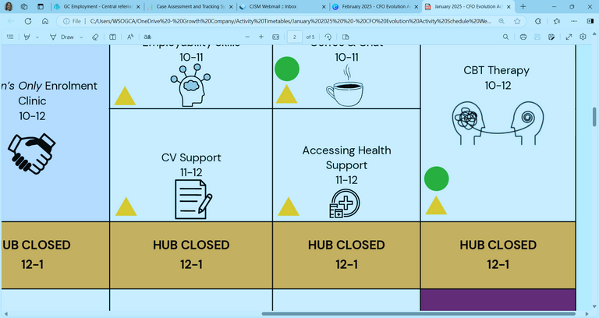
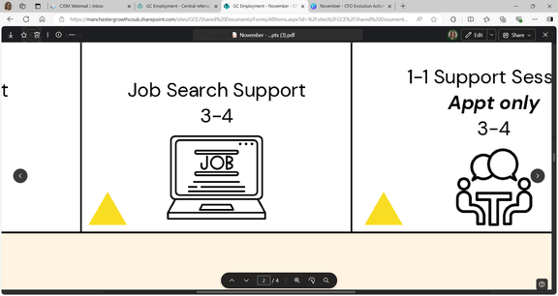
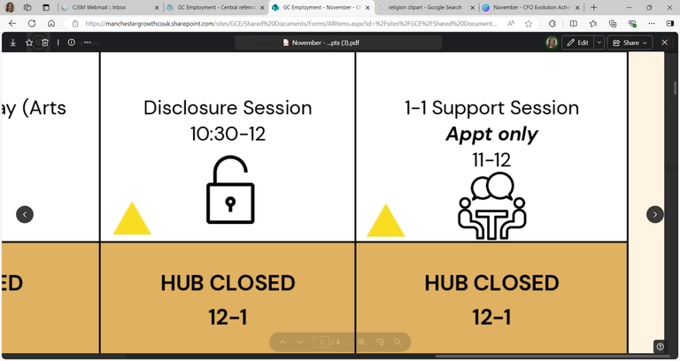

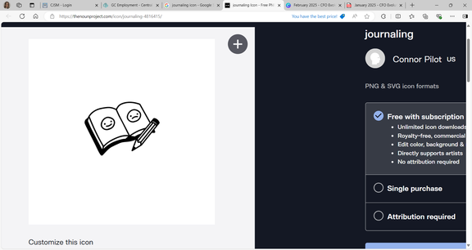
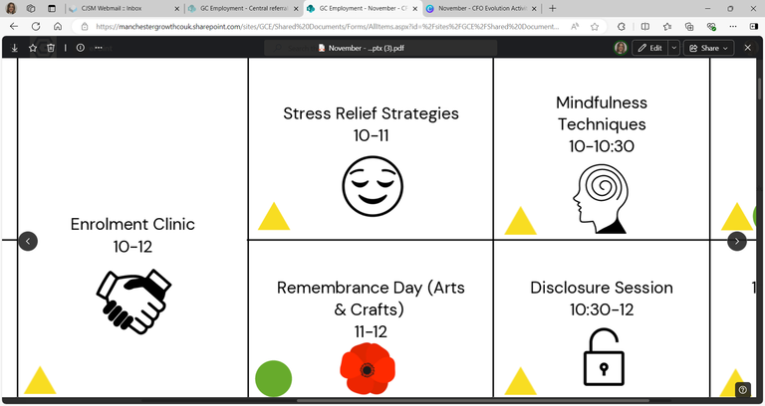










Self: Activities that work on the individual
JULY - WEEK 1
Relationships: Activities that work with peers/families/friends
Society: Activities contributing to the community outside of the CFO Activity Hub
Monday 30th | Tuesday 1st |  | Wednesday 2nd | Thursday 3rd | Friday 4th
 |  |  | Enrolment Clinic 9:30 - 10:30 | Wellbeing Hub Walk 9:30 - 10:30
 |  |  | Disclosure 10:30 - 12 | Strong Ties to Family & Pro-Social Personal Support 10:30 - 12
HUB CLOSED 12-1 | HUB CLOSED 12-1 |  | HUB CLOSED 12-1 | HUB CLOSED 12-1 | HUB CLOSED 12-1
 |  |  |  | Women’s Only Budgeting Session 1 - 3
 |  |  | Accessing Health Support 3 - 4 | Women’s Only Future Focus 3 - 4
Address:
First Floor Offices, Crabtree Street, Furthergate Industrial Estate, Blackburn, BB1 3BD
Contact Information:
07775 096192 (Gabriella)
07384 119231 (Nadya)
Enrolments are needed to do any of the activities.
Our 1:1 activities include; Housing, Employment, Training, Money Management, Healthcare and Enrolment, or you can book specific 1-1 support session with your support worker.
They are appointment only!
We offer group sessions such as Hub Walks around Corporation Park, Coffee & Chat Sessions, a Hub Quiz, various Arts and Craft sessions, and Cooking Sessions. Employment activities included Interview Prep, Completing Application Forms or just simply support with Job Searching/Training.
National Social Media Day:
Internet Safety Awareness
9:30 - 12
Appointment only. Please book with your support worker
Employability Skills
9:30 - 10:30
Digital College
9:30 - 12
CBT
Appt only
10 - 12
Job Search & Application Support
10:30 - 12
Personal Journaling
1 - 2
Stress Relief Strategies
1 - 2:30
Intro to Customer Service
1 - 4
TiPP
Art Session
1 - 3
CBT Therapy
Appt only
2 - 4
TiPP
Drama
Music
2 - 4
ETE Awards & Quiz
2:30 - 4
This programme is delivered by HMPPS CFO

Slide 2





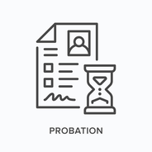

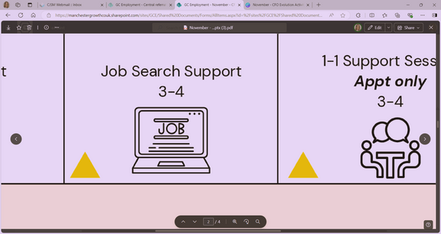




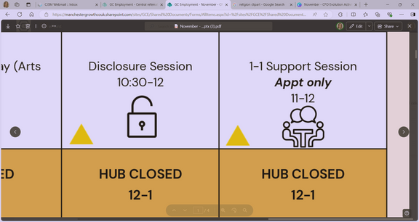

Self: Activities that work on the individual
JULY - WEEK 2
Relationships: Activities that work with peers/families/friends
Society: Activities contributing to the community outside of the CFO Activity Hub
Monday 7th | Tuesday 8th |  | Wednesday 9th | Thursday 10th |  |  | Friday 11th
Enrolment Clinic 9:30 - 11 |  |  |  |  |  |  | Mock Interview 9:30 - 10:30
Future Focus 11 - 12
HUB CLOSED 12-1 | HUB CLOSED 12-1 |  | HUB CLOSED 12-1 | HUB CLOSED 12-1 |  |  | HUB CLOSED 12-1
Housing Advice & Support 1 - 2 |  |  |  | Benefit Support 1 - 2:30
 |  |  | Reflective Practice 3 - 4 | In Work Support 2:30 - 4
Address:
First Floor Offices, Crabtree Street, Furthergate Industrial Estate, Blackburn, BB1 3BD
Contact Information:
07775 096192 (Gabriella)
07384 119231 (Nadya)
Enrolments are needed to do any of the activities.
Our 1:1 activities include; Housing, Employment, Training, Money Management, Healthcare and Enrolment, or you can book specific 1-1 support session with your support worker.
They are appointment only!
We offer group sessions such as Hub Walks around Corporation Park, Coffee & Chat Sessions, a Hub Quiz, various Arts and Craft sessions, and Cooking Sessions. Employment activities included Interview Prep, Completing Application Forms or just simply support with Job Searching/Training.
1-1 Support Session
Appt only
9:30 - 10:30
CV Support
9:30 - 11
Job Club
9:30 - 12
Enrolment Clinic
9:30 - 12
CBT
Appt only
10 - 12
Disclosure Session
10:30 - 12
Obtaining ID
11 - 12
Unpaid Work Support
10:30 - 12
Women’s Only
Job Search
1 - 2:30
TiPP
Art Session
1 - 3
Motivation Session
1 - 2
CBT Therapy
Appt only
2 - 4
TiPP
Drama
Music
2 - 4
Women’s Only
Disclosure Session
2:30 - 4
National Blueberry Muffin Day:
Baking Session
2 - 4
This programme is delivered by HMPPS CFO

Slide 3


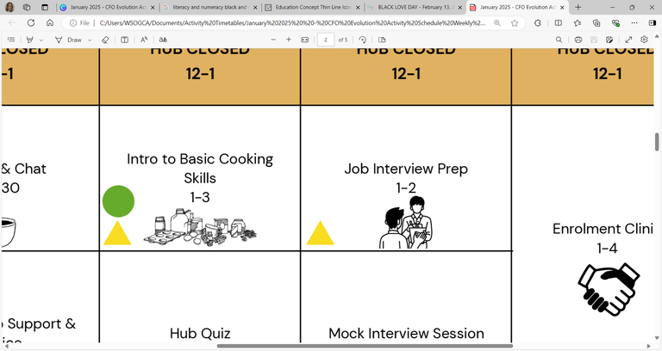







Self: Activities that work on the individual
JULY - WEEK 3
Relationships: Activities that work with peers/families/friends
Society: Activities contributing to the community outside of the CFO Activity Hub
Monday 14th | Tuesday 15th |  | Wednesday 16th | Thursday 17th | Friday 18th
Employability Skills 9:30 - 11 |  |  | Women’s Only CV Support 9:30 - 11 | Accessing a Bank Account 9:30 - 10:30
Interview Preparation 11 - 12 |  |  | Women’s Only Housing Advice & Support 11 - 12 | CV Support 10:30 - 12
HUB CLOSED 12-1 | HUB CLOSED 12-1 |  | HUB CLOSED 12-1 | HUB CLOSED 12-1 | HUB CLOSED 12-1
Confidence Building 1 - 2 |  |  |  | Mindfulness Yoga 1 - 2 | Feelings of Hope & Self-Efficiency 1 - 3
 |  |  | Mock Interview 3 - 4 | Creative Writing: Part 3 2 - 4 | Emotional Resilience 3 - 4
Address:
First Floor Offices, Crabtree Street, Furthergate Industrial Estate, Blackburn, BB1 3BD
Contact Information:
07775 096192 (Gabriella)
07384 119231 (Nadya)
Enrolments are needed to do any of the activities.
Our 1:1 activities include; Housing, Employment, Training, Money Management, Healthcare and Enrolment, or you can book specific 1-1 support session with your support worker.
They are appointment only!
We offer group sessions such as Hub Walks around Corporation Park, Coffee & Chat Sessions, a Hub Quiz, various Arts and Craft sessions, and Cooking Sessions. Employment activities included Interview Prep, Completing Application Forms or just simply support with Job Searching/Training.
Digital College
9:30 - 12
HUB CLOSED FOR STAFF TRAINING
CBT
Appt only
10 - 12
Where to Start and an Introduction to Employability
9:30 - 12
Enrolment Clinic
9:30 - 12
Literacy & Numeracy Assessment
1 - 2:30
CBT
Appt only
1 - 4
TiPP
Drama
Music
2 - 4
A Sense of New &
Pro-Social Identity
2:30 - 4
This programme is delivered by HMPPS CFO

Slide 4



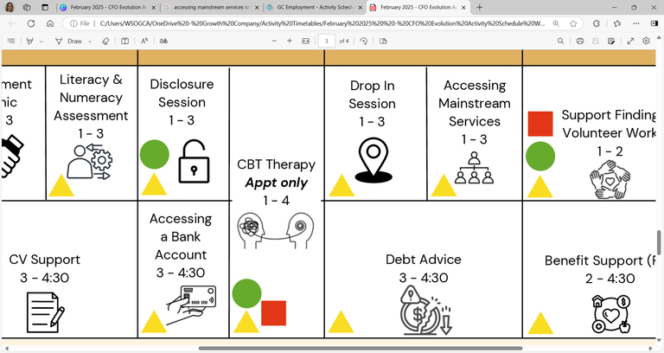




Self: Activities that work on the individual
JULY - WEEK 4
Relationships: Activities that work with peers/families/friends
Society: Activities contributing to the community outside of the CFO Activity Hub
Monday 21st | Tuesday 22nd |  | Wednesday 23rd | Thursday 24th |  | Friday 25th
 |  |  |  | 1-1 Support Session Appt only 9:30 - 10:30 |  | Women’s Only Digital College 9:30 - 12
HUB CLOSED 12-1 | HUB CLOSED 12-1 |  | HUB CLOSED 12-1 | HUB CLOSED 12-1 |  | HUB CLOSED 12-1
 |  |  |  | Budgeting Support 1 - 2
 |  |  | Stress Relief Strategies 3 - 4 | International Self Care Day: Self Care Session 2 - 4
National Be Someone Day:
Future Focusing on Professional and Personal Development Session
9:30 - 12
Address:
First Floor Offices, Crabtree Street, Furthergate Industrial Estate, Blackburn, BB1 3BD
Contact Information:
07775 096192 (Gabriella)
07384 119231 (Nadya)
Enrolments are needed to do any of the activities.
Our 1:1 activities include; Housing, Employment, Training, Money Management, Healthcare and Enrolment, or you can book specific 1-1 support session with your support worker.
They are appointment only!
We offer group sessions such as Hub Walks around Corporation Park, Coffee & Chat Sessions, a Hub Quiz, various Arts and Craft sessions, and Cooking Sessions. Employment activities included Interview Prep, Completing Application Forms or just simply support with Job Searching/Training.
Job Applications:
Cover Letter Support
9:30 - 11
CBT
Appt only
10 - 12
Intro to Customer Service
9:30 - 12
Job Search
11 - 12
Enrolment Clinic
10:30 - 12
In Work Support
10:30 - 12
Motivation Workshop
1 - 2:30
TiPP
Art Session
1 - 3
Unpaid Work Support
1 - 3
Debt Advice
1 - 2
CBT Therapy
Appt only
1 - 4
TiPP
Drama
Music
2 - 4
Healthy Eating & Living Techniques
2:30 - 4
Sports: Ping Pong
3 - 4
This programme is delivered by HMPPS CFO

Slide 5




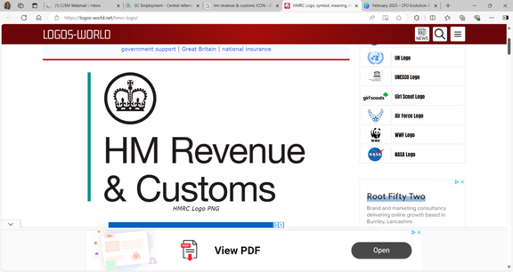





Self: Activities that work on the individual
JULY - WEEK 5
Relationships: Activities that work with peers/families/friends
Society: Activities contributing to the community outside of the CFO Activity Hub
Monday 28th | Tuesday 29th |  | Wednesday 30th | Thursday 31st |  | Friday 1st
Women’s Only Relationship Advice & Support 9:30 - 11 |  |  | International Friendship Day: Building Healthy Friendships within the Community Advice & Guidance Session 9:30 - 12
Women’s Only Accessing Health Support 11 - 12
HUB CLOSED 12-1 | HUB CLOSED 12-1 |  | HUB CLOSED 12-1 | HUB CLOSED 12-1 |  | HUB CLOSED 12-1
CV Support 1 - 2 |  |  |  | Digital College 1 - 2:30 |  | Confidence Building 1 - 2
 |  |  | Problem Solving Techniques 3 - 4 |  |  | Digital Skills Support 2 - 4
Address:
First Floor Offices, Crabtree Street, Furthergate Industrial Estate, Blackburn, BB1 3BD
Contact Information:
07775 096192 (Gabriella)
07384 119231 (Nadya)
Enrolments are needed to do any of the activities.
Our 1:1 activities include; Housing, Employment, Training, Money Management, Healthcare and Enrolment, or you can book specific 1-1 support session with your support worker.
They are appointment only!
We offer group sessions such as Hub Walks around Corporation Park, Coffee & Chat Sessions, a Hub Quiz, various Arts and Craft sessions, and Cooking Sessions. Employment activities included Interview Prep, Completing Application Forms or just simply support with Job Searching/Training.
Disclosure Session
9:30 - 11
1-1 Support Session
Appt only
9:30 - 10:30
Job Club
9:30 - 12
Where to Start and an Introduction to Employability
9:30 - 12
CBT
Appt only
10 - 12
Obtaining National Insurance
11 - 12
Enrolment Clinic
10:30 - 12
Accessing Health Support
1 - 2
TiPP
Art Session
1 - 3
CBT Therapy
Appt only
2 - 4
TiPP
Drama
Music
2 - 4
Cooking Session:
Chicken Curry
2 - 4
ETE Awards & Quiz
2:30 - 4
This programme is delivered by HMPPS CFO

