Slide 1






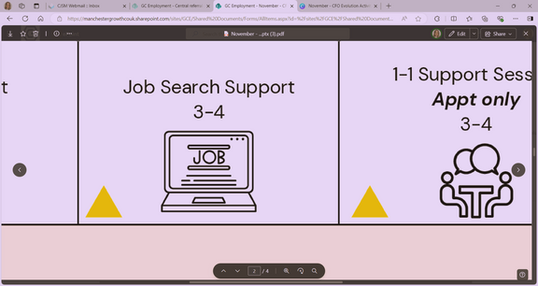

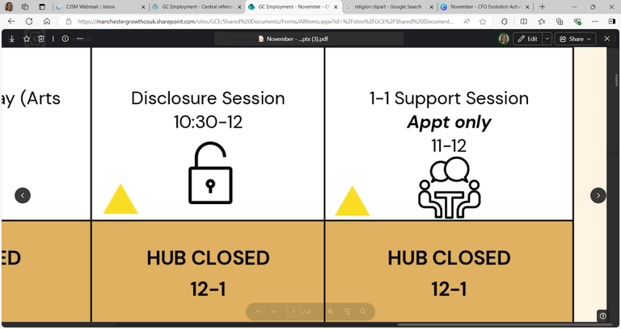

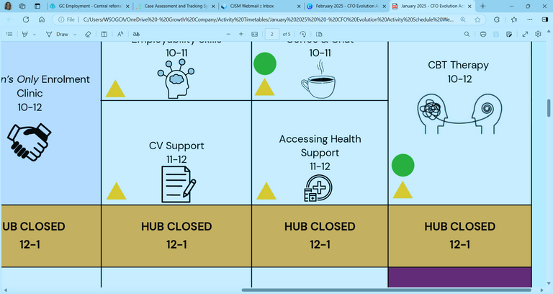

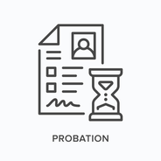
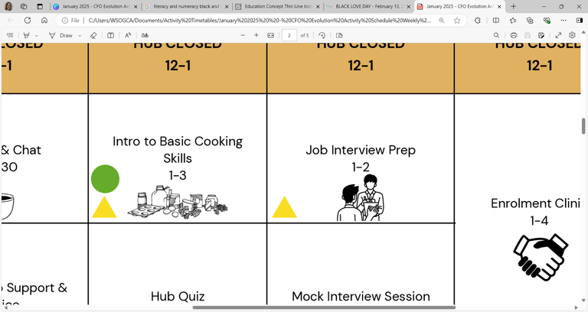

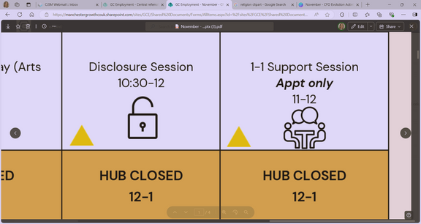









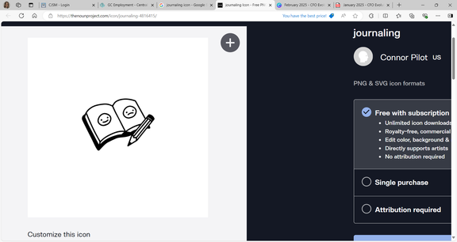



Self: Activities that work on the individual
SEPTEMBER - WEEK 1
Relationships: Activities that work with peers/families/friends
Society: Activities contributing to the community outside of the CFO Activity Hub
Monday 1st | Tuesday 2nd |  | Wednesday 3rd | Thursday 4th |  | Friday 5th
Women’s Only Job Search 9:30 – 11 |  |  | Disclosure 9:30 – 10:30
Women’s Only Disclosure 11 - 12 |  |  | Future Focus 10:30 - 12
HUB CLOSED 12-1 | HUB CLOSED 12-1 |  | HUB CLOSED 12-1 | HUB CLOSED 12-1 |  | HUB CLOSED 12-1
Motivation 1 - 2 |  |  |  | Budgeting Session 1 - 2 |  | Mock Interview Support 1 – 2:30
 |  |  | Reflective Practice 3 - 4 |  |  | Numeracy & Literacy Skills 2:30 – 4
Address:
First Floor Offices, Crabtree Street, Furthergate Industrial Estate, Blackburn, BB1 3BD
Contact Information:
07775 096192 (Gabriella)
07384 119231 (Nadya)
07712 511792 (Aisha)
Enrolments are needed to do any of the activities.
Our 1:1 activities include; Housing, Employment, Training, Money Management, Healthcare and Enrolment, or you can book specific 1-1 support session with your support worker.
They are appointment only!
We offer group sessions such as Hub Walks around Corporation Park, Coffee & Chat Sessions, a Hub Quiz, various Arts and Craft sessions, and Cooking Sessions. Employment activities included Interview Prep, Completing Application Forms or just simply support with Job Searching/Training.
Enrolment Clinic
9:30 - 11
CV Preparation
9:30 - 11
Job Club
9:30 - 12
Unpaid Work Support
9:30 - 12
CBT
Appt only
10 - 12
Interview Prep
11 - 12
1-1 Support Session
Appt only
11 - 12
Self Care
1 – 2:30
TiPP
Art Session
1 - 3
CBT Therapy
Appt only
1 - 4
TiPP
Drama
Music
2 - 4
Personal Journaling
2:30 - 4
World Samosa Day
Cooking Session
2 - 4
This programme is delivered by HMPPS CFO

Slide 2

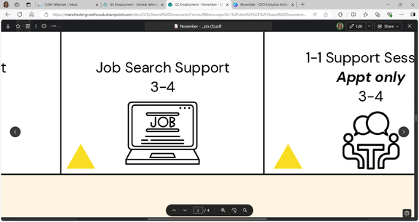














Self: Activities that work on the individual
SEPTEMBER - WEEK 2
Relationships: Activities that work with peers/families/friends
Society: Activities contributing to the community outside of the CFO Activity Hub
Monday 8th |  | Tuesday 9th |  | Wednesday 10th | Thursday 11th | Friday 12th
 |  | Digital College 9:30 - 12 |  | Employability Skills 9:30 - 11 | Job Search 9:30 – 10:30
 |  |  |  | Accessing a Bank Account 11 - 12 | Cover Letter Support 10:30 - 12
HUB CLOSED 12-1 |  | HUB CLOSED 12-1 |  | HUB CLOSED 12-1 | HUB CLOSED 12-1 | HUB CLOSED 12-1
 |  |  |  |  | Women’s Only Accessing Health Support 1 – 2:30 | Benefit Support 1 – 2:30
 |  |  |  | World Suicide Prevention Day: Suicide Awareness Session 3 - 4 | Women’s Only Relationship Support & Advice 2:30 – 4 | Stand Up To Cancer Day Awareness & Support 2:30 - 4
Address:
First Floor Offices, Crabtree Street, Furthergate Industrial Estate, Blackburn, BB1 3BD
Contact Information:
07775 096192 (Gabriella)
07384 119231 (Nadya)
07712 511792 (Aisha)
Enrolments are needed to do any of the activities.
Our 1:1 activities include; Housing, Employment, Training, Money Management, Healthcare and Enrolment, or you can book specific 1-1 support session with your support worker.
They are appointment only!
We offer group sessions such as Hub Walks around Corporation Park, Coffee & Chat Sessions, a Hub Quiz, various Arts and Craft sessions, and Cooking Sessions. Employment activities included Interview Prep, Completing Application Forms or just simply support with Job Searching/Training.
Obtaining National Insurance
9:30 – 10:30
1-1 Support Sessions
Appt only
9:30 - 12
Enrolment Clinic
9:30 - 12
Introduction to Labouring
9:30 - 12
CBT
Appt only
10 - 12
In Work Support
10:30 - 12
Optimism & Self-Worth
1 - 2:30
TiPP
Art Session
1 - 3
Victim Awareness
1 - 2
CBT Therapy
Appt only
1 - 4
TiPP
Drama
Music
2 - 4
Emotional Resilience
2:30 - 4
This programme is delivered by HMPPS CFO

Slide 3










Self: Activities that work on the individual
SEPTEMBER - WEEK 3
Relationships: Activities that work with peers/families/friends
Society: Activities contributing to the community outside of the CFO Activity Hub
Monday 15th | Tuesday 16th |  | Wednesday 17th | Thursday 18th |  |  | Friday 19th
Disclosure 9:30 – 10:30 |  |  |  |  |  |  | Interview Preparation 9:30 – 10:30
Future Focus 10:30 - 12
HUB CLOSED 12-1 | HUB CLOSED 12-1 |  | HUB CLOSED 12-1 | HUB CLOSED 12-1 |  |  | HUB CLOSED 12-1
Mindfulness Techniques 1 - 2 |  |  |  | Addiction Support 1 – 2:30 |  |  | Relationship Advice & Support 1 – 2:30
 |  |  | Problem Solving Techniques 3 - 4 | Feelings of Hope & Self-Efficiency 2:30 - 4
Industry Specific Cards
9:30 -10:30
CV Support
9:30 – 11
Intro to Labouring
9:30 - 12
Enrolment Clinic
9:30 - 12
CBT
Appt only
10 - 12
Sentence Requirement Support
10:30 - 12
Job Application Support
11- 12
Mock Interviews
10:30- 12
Women’s Only
Housing Support
1 - 2:30
TiPP
Art Session
1 - 3
CBT Therapy
Appt only
2 - 4
TiPP
Drama
Music
2 - 4
Women’s Only
CV Support
2:30 - 4
World Paella Day
Cooking Session
2:30 - 4
This programme is delivered by HMPPS CFO

Slide 4












Self: Activities that work on the individual
SEPTEMBER - WEEK 4
Relationships: Activities that work with peers/families/friends
Society: Activities contributing to the community outside of the CFO Activity Hub
Monday 22nd | Tuesday 23rd |  | Wednesday 24th | Thursday 25th |  | Friday 26th
Unpaid Work Support 9:30 - 11 |  |  | Women’s Only Motivation Session 9:30 – 10:30 |  |  | Obtaining ID 9:30 – 10:30
Employability Skills 11 - 12 |  |  | Women’s Only Digital College 10:30 - 12 |  |  | Job & Course Searching 10:30 - 12
HUB CLOSED 12-1 | HUB CLOSED 12-1 |  | HUB CLOSED 12-1 | HUB CLOSED 12-1 |  | HUB CLOSED 12-1
Anger Management 1 - 2 |  |  | TiPP Art Session 1 - 3 | Healthy Living Techniques 1 - 3 |  | New & Pro-Social Identity 1 – 3
 |  |  | Accessing Health Support 3 - 4 | National Fitness Day Ping Pong Session 3 - 4 |  | Hub Quiz 3 - 4
Enrolment Clinic
9:30 - 12
CBT
Appt only
10 - 12
MacMillan Coffee Morning
9:30 - 12
Confidence Building
1 - 2
CBT
Appt only
1 - 4
TiPP
Drama
Music
2 - 4
Accessing Mainstream Services
2 - 4
This programme is delivered by HMPPS CFO

Slide 5







Self: Activities that work on the individual
SEPTEMBER - WEEK 5
Relationships: Activities that work with peers/families/friends
Sentence Requirement Support
9:30 – 10:30
Society: Activities contributing to the community outside of the CFO Activity Hub
Monday 29th | Tuesday 30th |  | Wednesday 1st | Thursday 2nd | Friday 3rd
 |  |  | Job Club 9:30 - 12 | Hub Canal Walk 9:30 - 12 | Enrolment Clinic 9:30 - 11
 |  |  |  |  | Disclosure 11 - 12
HUB CLOSED 12-1 | HUB CLOSED 12-1 |  | HUB CLOSED 12-1 | HUB CLOSED 12-1 | HUB CLOSED 12-1
Self Care 1 - 2 |  |  |  | Women’s Only Sentence Requirement Support 1 – 2:30 | Housing Advice & Support 1 – 2:30
 |  |  | Wellbeing Goal Setting 3 - 4 | Women’s Only Benefit Support 2:30 - 4 | Therapeutic Art 2:30 - 4
Where to Start and an Introduction to Employability
9:30 - 12
CBT
Appt only
10 - 12
Digital College
10:30 - 12
Debt Management & Budgeting
1 – 3
TiPP
Art Session
1 - 3
CBT Therapy
Appt only
1 - 4
TiPP
Drama
Music
2 - 4
ETE Awards & Quiz
3 - 4
This programme is delivered by HMPPS CFO

