Slide 1
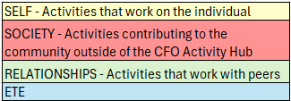


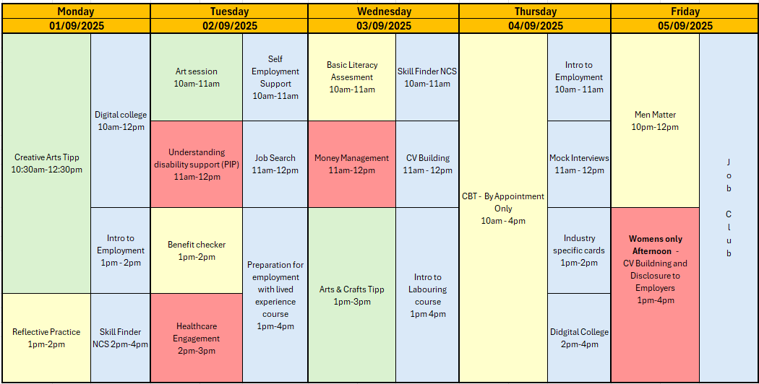

















SEPTEMBER - WEEK 1
Information
Address: - Urban Exchange, Theatre Street/Mount Street, Preston, PR1 8BQ
Contact: 07850 955413 (AMY)
Enrolments are needed to do any of the sessions.
Group Activity's this week include Arts and Crafts, and Creative arts which will be run by an external provider additionally there is a creative writing group and A men matter group which will be run by one of the male support workers discussing men’s mental health struggles.
– Please let your support worker know if you would like to sign up for any of these.
CBT To be discussed with Support worker
2-week course running at the Hub for the CSCS GREEN CARD (Mon-Fri 9am-3pm) – Please notify Support worker if interested Inductions for the course to be completed NEXT WEEK
This programme is delivered by HMPPS CFO
V1.0

Slide 2
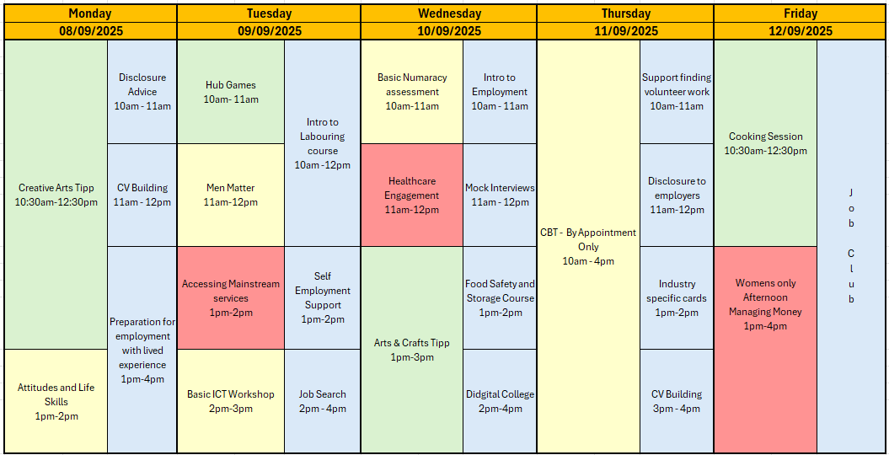







SEPTEMBER - WEEK 2
Information
Address: - Urban Exchange, Theatre Street/Mount Street, Preston, PR1 8BQ
Contact: 07850 955413 (AMY)
Enrolments are needed to do any of the sessions.
Group Activity's this week include Arts and Crafts, Creative arts and A table tennis competition as well as the Cooking session (we advise you join the food safety course prior) and Creative arts which will be run by an external provider – Please let your support worker know if you would like to sign up for any of these.
CBT To be discussed with Support worker
Induction for CSCS GREEN CARD Course
10am - 1pm
2-week course running at the Hub for the CSCS GREEN CARD (Mon-Fri 9am-3pm) – Please notify Support worker if interested Inductions for the course to be completed TUESDAY 9TH
This programme is delivered by HMPPS CFO
V1.0

Slide 3
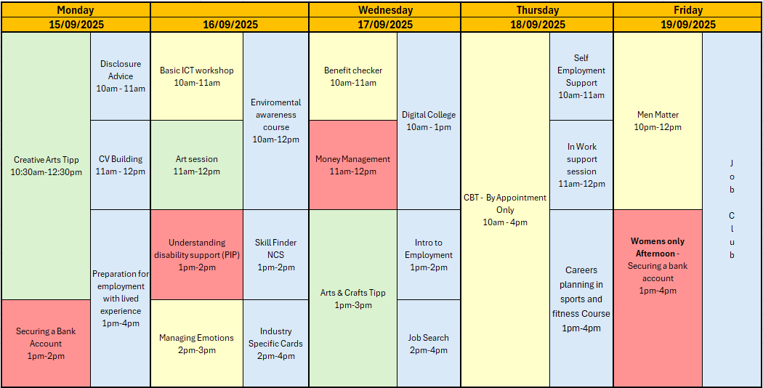

SEPTEMBER - WEEK 3
WEEK 1: CSCS GREEN CARD (In Person) TRAINING: MON – FRI 9am-3pm
Information
Address: - Urban Exchange, Theatre Street/Mount Street, Preston, PR1 8BQ
Contact: 07850 955413 (AMY)
Enrolments are needed to do any of the sessions.
Group Activity's this week include Arts and Crafts and Creative arts which will be run by an external provider and , Table tennis, A men matter group which will be run by one of the male support workers discussing men’s mental health struggles.
– Please let your support worker know if you would like to sign up for any of these.
CBT To be discussed with Support worker
2-week course running at the Hub for the CSCS GREEN CARD (Mon-Fri 9am-3pm) – Please notify Support worker if interested Inductions for the course to be completed 1-1 week prior
This programme is delivered by HMPPS CFO
V1.0

Slide 4
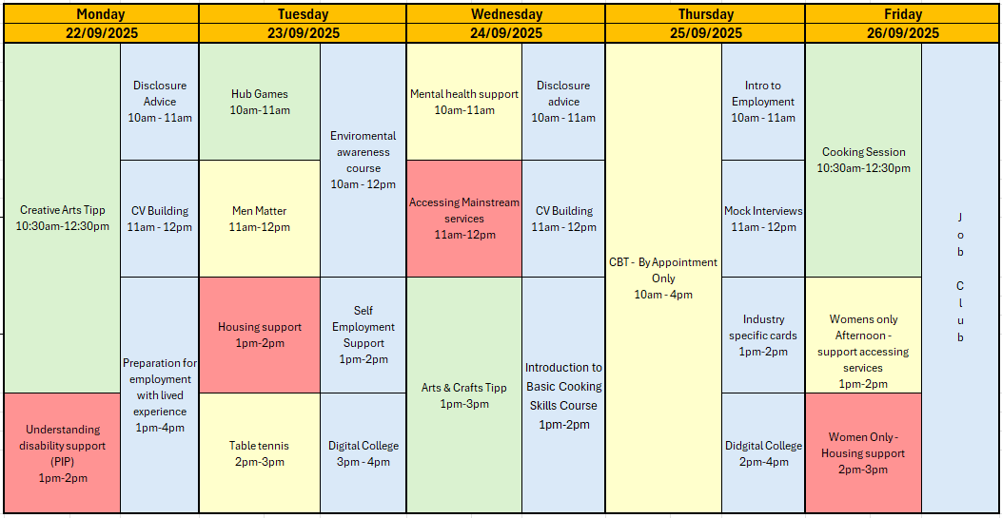


SEPTEMBER - WEEK 4
WEEK 2: CSCS GREEN CARD (In Person) TRAINING: MON – FRI 9am-3pm
Information
Address: - Urban Exchange, Theatre Street/Mount Street, Preston, PR1 8BQ
Contact: 07850 955413 (AMY)
Enrolments are needed to do any of the sessions.
Group Activity's this week include Creative Writing, and the Creative art group run by Tipp as well as a basic ICT workshop– Please let your support worker know if you would like to sign up for any of these.
We will also be running a baking session at the Hub this week
CBT To be discussed with Support worker
Week 2 of course running at the Preston Hub for the CSCS GREEN CARD (Mon-Fri 9am-3pm)
This programme is delivered by HMPPS CFO
V1.0

